Slide 1
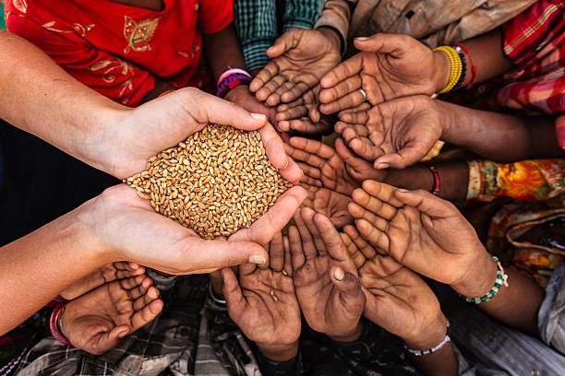
Embracing Modernity While Preserving Tradition
The Role of Innovative Cooking Technologies in Sustaining African Culinary Heritage
By Dr Bridget O. Menyeh
9th May 2024
African Heritage Conference

Slide 2
Presentation Outline
Brief Context
Challenges of African Cooking Methods
State of access to clean cooking
Achieving Universal Access and Fuel mixes
Challenges with cooking with electricity
Achieving a just transition
Conclusions

Slide 3
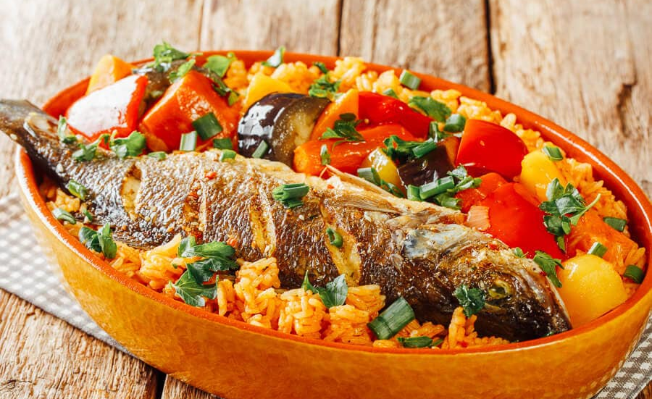
Context: Food and Heritage
Food is a key element in the preservation and representation of cultural heritage(Di Giovine and Brulotte, 2016)
UNESCO recognizes certain food practices as intangible cultural heritage.
Example, Ceebu Jen from Senegal (Inscribed in 2021). Recipe and techniques are traditionally passed down from mother to daughter

Slide 4
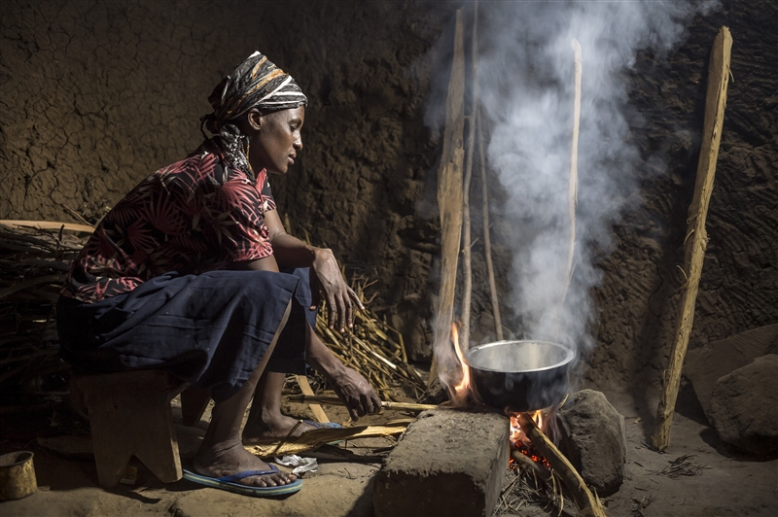
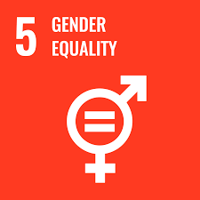
Challenges of African Cooking Methods
Health Concerns
Environmental Concerns
Gender inequality
Image credit: Hivos

Slide 5
What is the state of access to clean cooking?
SSA (2021)
~ 500 million people without access
940 million people without access

Slide 6
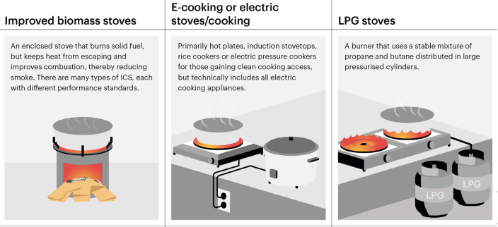
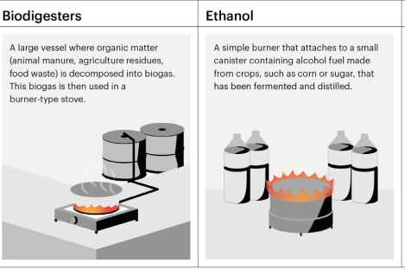
Outlook to 2030 (Access for all Scenario)
Source: IEA(2023)

Slide 7
Source: IEA(2023)
Notes:
.

Slide 8
Outlook toward 2050 in emerging market and developing economies
Source: IEA(2023)

Slide 9
Evidence from Consumer trials and pilots
The Modern Energy Cooking Services programme has demonstrated through its pilots and trials that cooking with electricity is hindered by (often false) perceptions around
Cost
Taste and safety
Lack of awareness or availability of aftersales service
Access to reliable electricity
Reluctance of male decisionmakers to authorise appliance purchase
( Leary et al.,2021)
Image credit: MECS

Slide 10
How can Africans Become Part of the Change?
Climate change is influencing the way things are done
Modern Cookstove design and manufacturing needs to involve Africans and way for innovating on our biomass type stoves.
Some manufacturing facilities like Burn in Kenya
How can we upskill the stove developers and people who work in the wood and charcoal informal sector?
These are all considerations to ensure the preservation of African food heritage.

Slide 11
Summary and Conclusions
The dependence on biomass fuels in African cooking practices is having on toll on the health of women and girls, impacting the environment and hindering the attainment of gender equality
Accelerated efforts are required to achieve universal access by 2030.
Studies have shown that modern cooking appliances or fuels can address the challenges and ensure preservation of some African food or dishes. This can be achieved with a multi-use strategy
Future towards 2050 will see electric cooking as the norm, despite the benefits, jobs in the wood and charcoal sector at risk. Building manufacturing capabilities needed for a just transition.

Slide 12
References
IEA (2023), A Vision for Clean Cooking Access for All, IEA, Paris https://www.iea.org/reports/a-vision-for-clean-cooking-access-for-all, Licence: CC BY 4.0
Di Giovine, M. A., & Brulotte, R. L. (2016). Introduction food and foodways as cultural heritage. In Edible identities: Food as cultural heritage (pp. 1-27). Routledge.
Leary, J., Menyeh, B., Chapungu, V., & Troncoso, K. (2021). ECooking: Challenges and opportunities from a consumer behaviour perspective. Energies, 14(14), 4345.

Slide 13
Thank you for your attention

